Slide 1
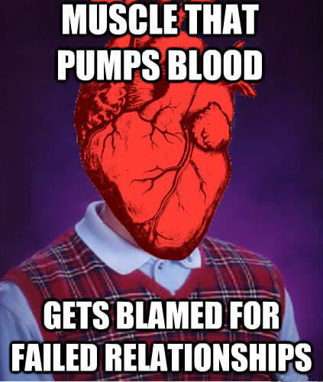
Those Heartbeat Graphs
A hilarious science meme

Slide 2
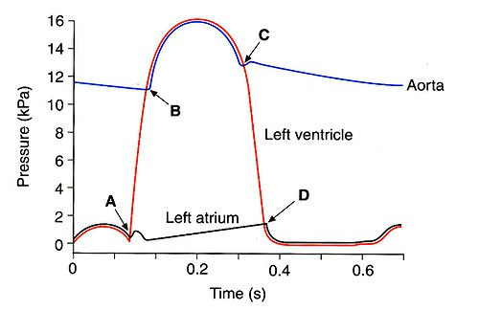
Ventricular
Systole
Aorta
Highest pressures are during systole
Ventricle
Atria
Atrial
Systole
Diastole

Slide 3
Blood forced out of ventricles
Blood forced into Aorta
Aorta
Ventricle
Ventricles empty
All blood forced into ventricles
Atria
Atrium begins filling with blood

Slide 4
Semilunar valve closes
Aorta
Semilunar valve opens
Ventricle
Semilunar valves at the top – The moon can be seen high in the sky.
AV valve closes
Atria
AV valve opens

Slide 5
Ventricular
Systole
Semilunar valve closes
Blood forced out of ventricles
Blood forced into Aorta
Aorta
Semilunar valve opens
Ventricle
Ventricles empty
All blood forced into ventricles
AV valve closes
Atria
AV valve opens
Atrial
Systole
Diastole
Atrium begins filling with blood

Slide 6
Reading ECGs
Ventricular Systole
Atrial Systole
Diastole

